Slide 1
Classification

Slide 2
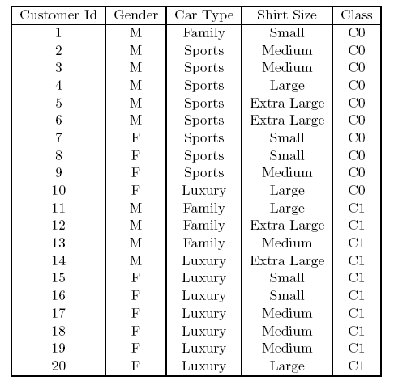


How to determine the Best Split
Before Splitting: 10 records of class 0 (c0), 10 records of class 1 (c1)
What are the values of the label for this data? How many cases / records for each label.
Learn the type of each attribute / feature, their values.
Which test condition is the best?

Slide 3
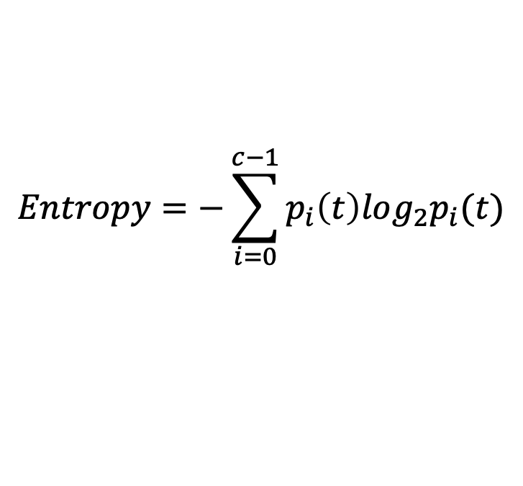
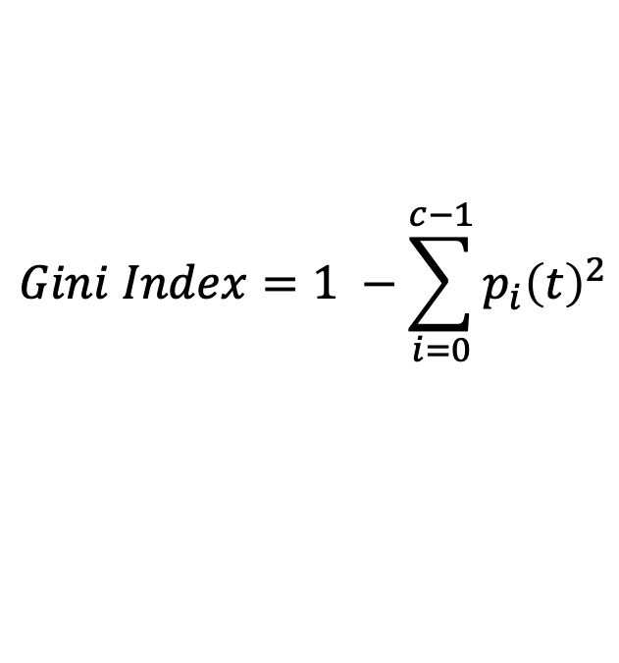
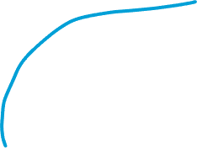
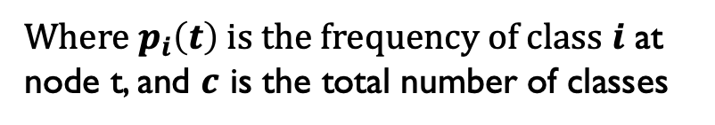
Measures of Node Impurity
Gini Index
Entropy
Misclassification error (confusing matrix for decision tree)
$$Gini Index=1 −\sum_{i=0}^{c−1}{p_{i}{\left(t\right)}^{2}}$$
Where $p_{i}\left(t\right)$ is the frequency of class $i$ at node t, and $c$ is the total number of classes
$$Entropy=−\sum_{i=0}^{c−1}{p_{i}\left(t\right)log_{2}p_{i}(t)}$$
$$Classification error={1 −max⁡[p}_{i}(t)]$$

Slide 4
Finding the Best Split
Compute impurity measure (P) before splitting
Compute impurity measure (M) after splitting
Compute impurity measure of each child node
M is the weighted impurity of child nodes
Choose the attribute test condition that produces the highest gain
Gain = P - M or equivalently, lowest impurity measure after splitting (M)

Slide 5
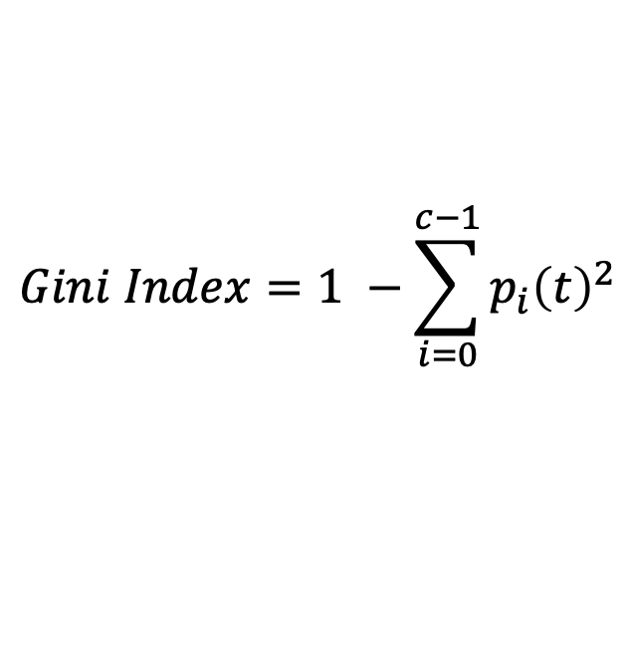
Gini Index
What is Gini Index?
Gini index or Gini impurity measures the degree or probability of a particular variable being wrongly classified when it is randomly chosen.
But what is actually meant by ‘impurity’?
If all the elements belong to a single class, then it can be called pure.
The degree of Gini index varies between 0 and 1, 0: all elements belong to a certain class or if there exists only one class, and 1: the elements are randomly distributed across various classes.
A Gini Index of 0.5 denotes equally distributed elements into some classes.
$$Gini Index=1 −\sum_{i=0}^{c−1}{p_{i}{\left(t\right)}^{2}}$$

Slide 6
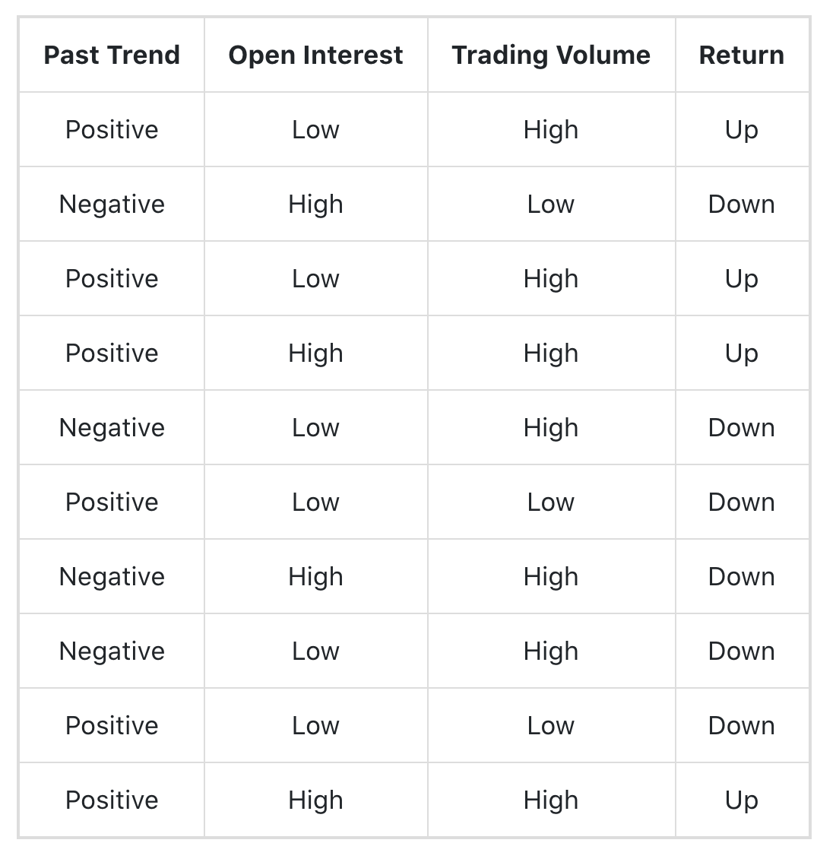
Example of Gini Index
Goal: calculate the Gini index for feature / attribute “past trend”
Step1: find the values of this features (positive, negative)
Step2: For each value of this feature, we look at the corresponding labels and calculate the GI for this value.
G(PT) = p(PT=P) *G(PT=P) + p(PT=N)*G(PT=N)
P(up|postive) = 4/6; p(down|positive) = 2/6
p(up|negavite) = 0/4; p(down|negative) = 4/4;
GI ( past trend = positive) = 1 – [ (4/6)^2 + (2/6)^2] = 0.45
GI (past trend = negative) = 1 – [ (0)^2 +1^2] = 0
GI ( past trend) = p(postive) * GI(positive) + p(negative) *GI(negative)
=( 6/10)*0.45 + (4/10) * 0 = 0.27

Slide 7

Example of Gini Index
Goal: calculate the GI for the attribute / feature: open interest
Find all the unique values of OI ( Low, high)
For each value (L or H), we look at all the labels of each values.
G(OI) = P(OI = LOW)*G(OI=LOW) + P(OI=HIGH)*G(OI=HIGH)
P(OI=LOW) = 6/10; P(OI=HIGH) = 4/10
G(OI=LOW) = 1 – [P(L=UP |OI=LOW)^2 + P(L=DOWN|OI=LOW)^2]
= 1 – [(2/6)^2 + (4/6)^2 ]
G(OI=HIGH) = 1 – [0.5^2 + 0.5^2]
3. Calculate the GI for each value

Slide 8
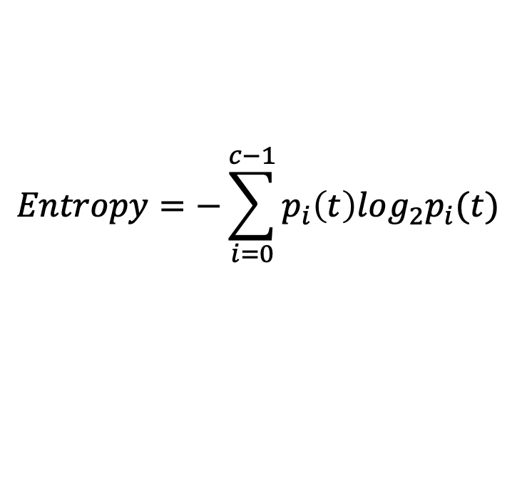
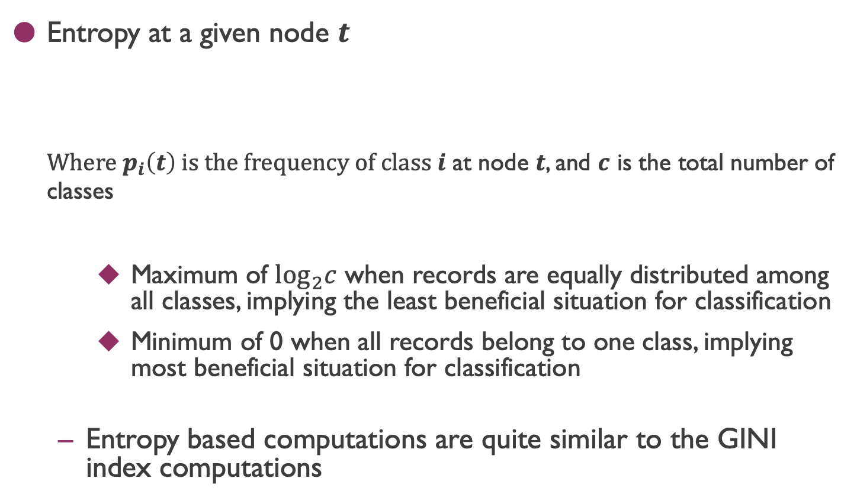
Measure of Impurity: Entropy
Entropy at a given node $t$
Where $p_{i}\left(t\right)$ is the frequency of class $i$ at node $t$, and $c$ is the total number of classes
Maximum of $\log_{2}c$ when records are equally distributed among all classes, implying the least beneficial situation for classification
Minimum of 0 when all records belong to one class, implying most beneficial situation for classification
Entropy based computations are quite similar to the GINI index computations
$$Entropy=−\sum_{i=0}^{c−1}{p_{i}\left(t\right)log_{2}p_{i}(t)}$$

Slide 9
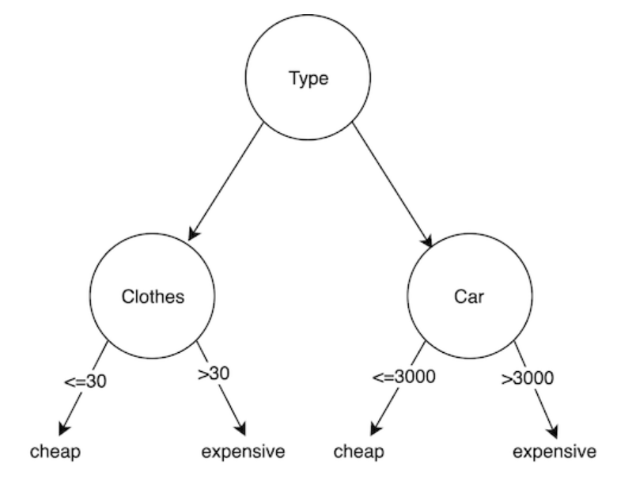
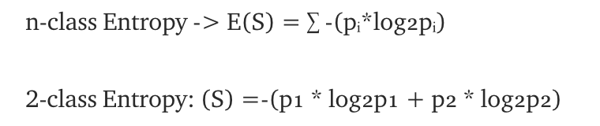
Entropy
Entropy known as the controller for decision tree to decide where to split the data.

Slide 10


Entropy
Sample Count | Sample Label
9 | A
5 | B
$$S=−\{ p_{a} ×\log_{2}{p_{a}} +p_{b} ×\log_{2}{p_{b}}\}$$

Slide 11

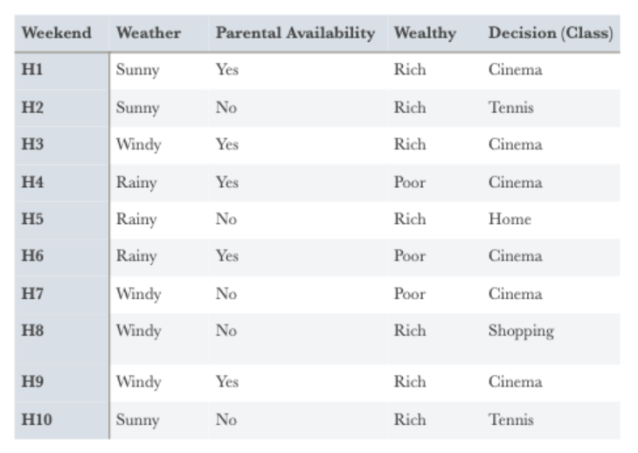

Information Gain
Goal: (1). Calculate the entropy for the dataset
How many labels do you have ( more than two)

Slide 12
Information Gain
Goal: (1). Calculate the entropy for the dataset
How many labels do you have ( more than two)

Slide 13
Information Gain
Goal: (1). Calculate the entropy for the dataset
How many labels do you have ( more than two)
Calculate the entropy of each value for one attribute

Slide 14
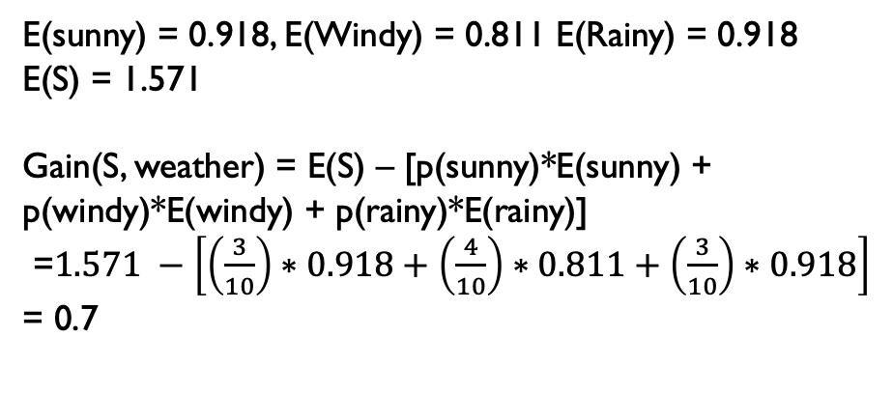
Information Gain
Goal: (1). Calculate the entropy for the dataset
How many labels do you have ( more than two)
Calculate the entropy of each value for one attribute
E(sunny) = 0.918, E(Windy) = 0.811 E(Rainy) = 0.918
E(S) = 1.571
Gain(S, weather) = E(S) – [p(sunny)*E(sunny) +
p(windy)*E(windy) + p(rainy)*E(rainy)]
=$1.571 −\left[\left(\frac{3}{10}\right)∗0.918+\left(\frac{4}{10}\right)∗0.811+\left(\frac{3}{10}\right)∗0.918\right]$
= 0.7

